Slide 1
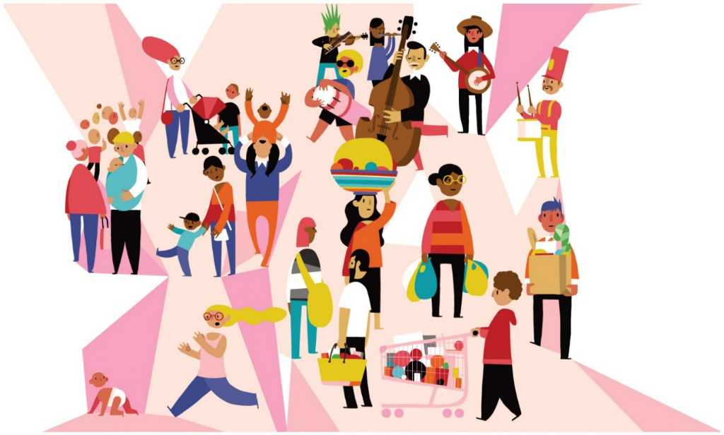
Culture
Ms. Kauser Malik
Lecturer (Sciences & Humanities)

Slide 2
Learning Objectives
Definition of culture
Material and non material culture
Elements of culture

Slide 3
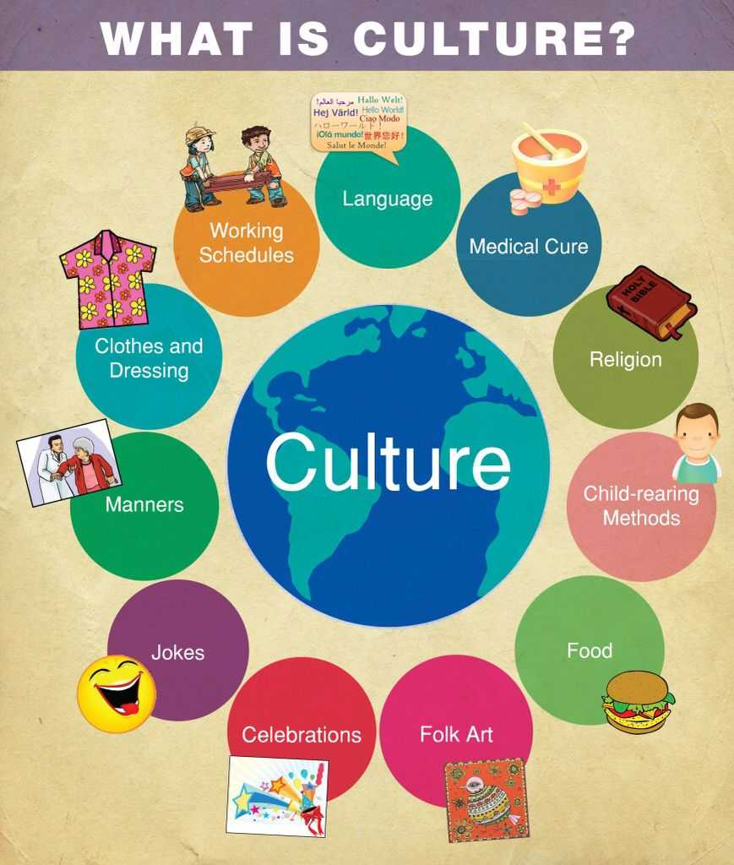

Slide 4
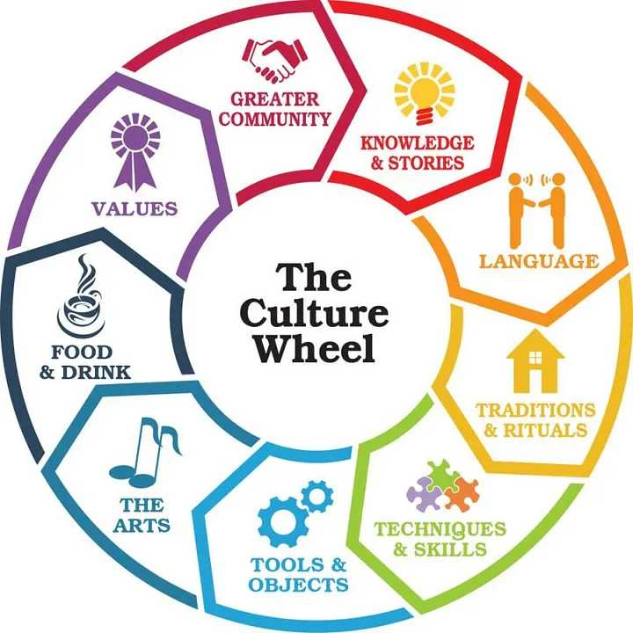
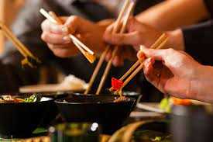
Culture
The language, beliefs, values, norms, behaviors, traditions and even material objects that characterize a group and are passed from one generation to the next.
It’s a set of acceptable behavioral patterns, values, assumptions and shared common experiences.
For example: Eating with chopsticks in China.

Slide 5
Types of Culture
1. Material Culture
Consists of human technology—all the things human beings make and use, from small, hand held tools to skyscrapers. It includes all the material things that are created by human beings.
Cultural artifacts
The material objects physical objects that distinguish a group of people, such as their art, buildings, weapons, utensils, machines, hairstyles, clothing, jewelry and worshiping places.
Example: Metro passes and bus tokens are part of material culture, as are automobiles, stores, and the physical structures where people worship.

Slide 6
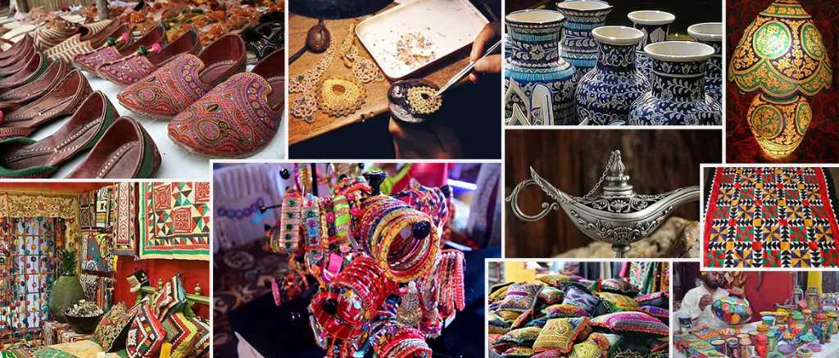

Slide 7
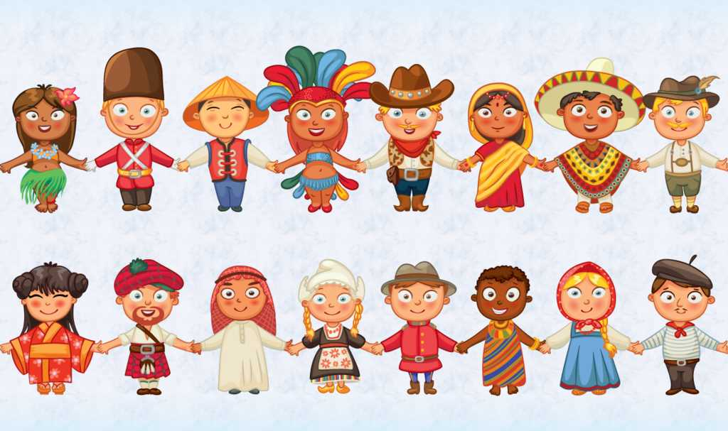
2. Non Material Culture
Thoughts or ideas that makeup the culture.
A group’s ways of thinking (including its beliefs, values, and other assumptions about the world) and doing (its common patterns of behavior, including language and other forms of interaction); also called symbolic culture.
It is about how to behave and interact in the world.
Examples: laws, norms, language, values. North African assumptions that it is acceptable to stare at others in public and to push people aside to buy tickets are examples of nonmaterial culture.
Are intangible

Slide 8
Basic Components of Culture
Language
Values and Beliefs
Mores
Folkways
Taboos
Norms

Slide 9
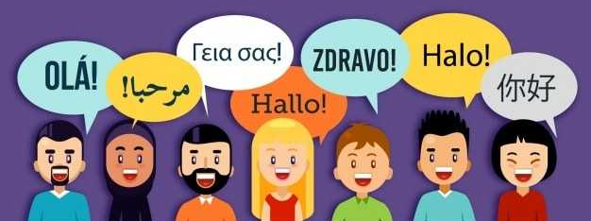
Language
The principal method of human communication, consisting of words used in a structured and conventional way and conveyed by speech. Each word is actually a symbol, a sound to which we have attached some particular meaning. Although all human groups have language, there is nothing universal about the meanings given to particular sounds.
The key to the world of culture, is a system of symbols that allows people to communicate with one another. Language not only allows communication but is also the key to cultural transmission, the process by which one generation passes culture to the next.

Slide 10
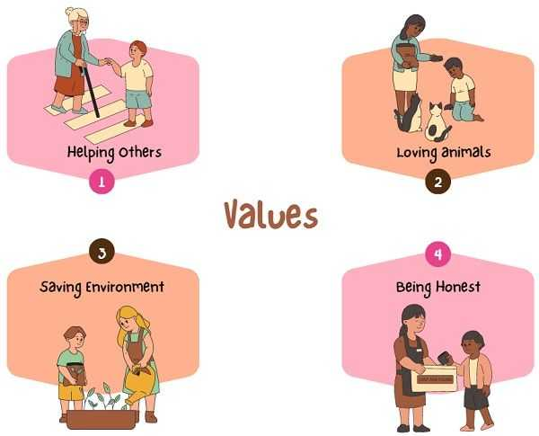
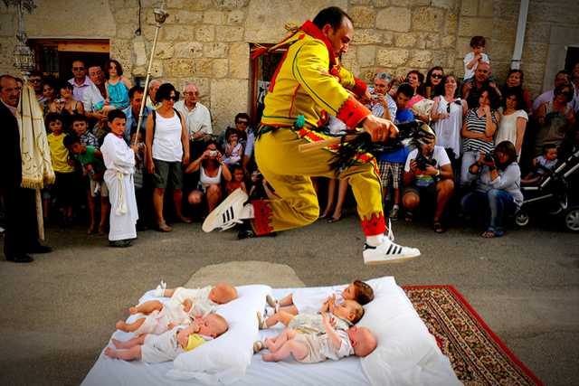
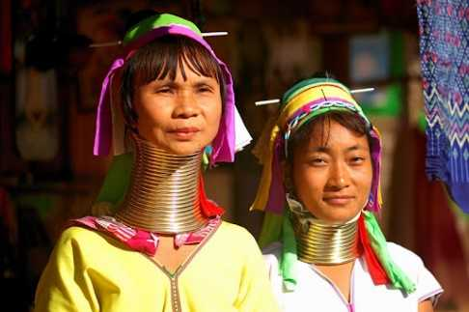
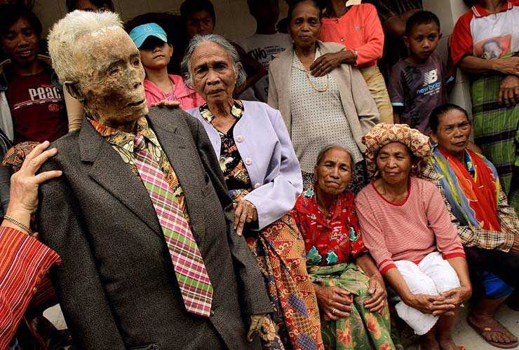
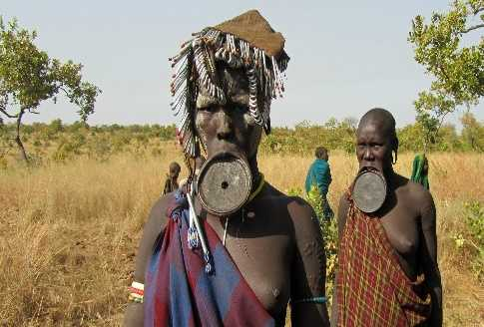
Values and Beliefs
Values
Beliefs
Culturally defined standards that people use to decide what is desirable, good, and beautiful and that serve as broad guidelines for social living.
Specific thoughts or ideas that people hold to be true.
In other words, values are abstract standards of goodness, and beliefs are particular matters that individuals consider true or false.
For example, because most U.S. adults share the value of providing equal opportunities for all, they believe that a qualified woman could serve as president of the United States, as Hillary Clinton’s presidential campaigns have demonstrated.

Slide 11
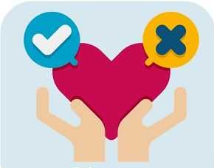
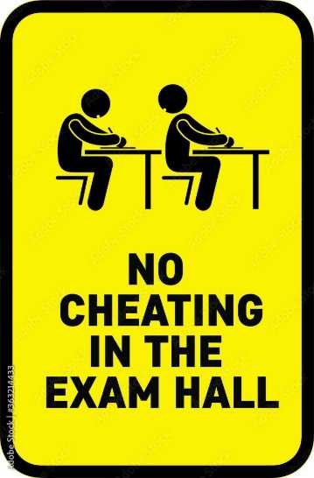
Norms
Rules or expectations that are socially enforced.
Expectations of “right” behavior
E.g., Encouraging positive behavior be honest or discouraging negative behavior. for example, “do not cheat”).
Forming a line at store counters, saying 'bless you' when someone sneezes, or holding the door to someone entering a building right after you.

Slide 12
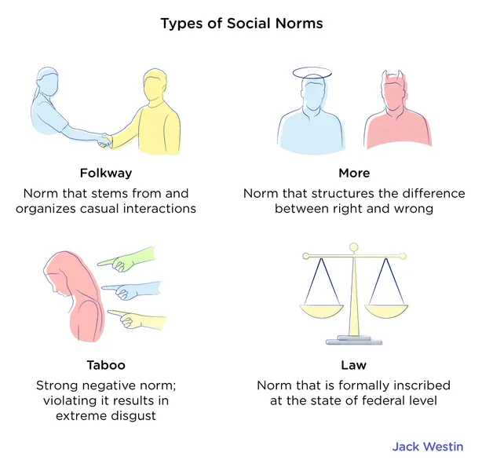

Slide 13
Mores
Mores (MORE-rays) are moral norms, meaning they have an element of right or wrong. They are often linked to religious beliefs.
Refers to society’s most deeply held rules that often carry a moral connotation, dictating what is considered significantly right or wrong.
Mores arise when groups live together long enough to develop shared understandings about how members should behave. They can be based on customs (traditional ways of doing things), religion, or peer pressure.
Mores and laws refer to the standards of behavior considered the most important in any society. We think of them as essential to our core values, and we insist on conformity.
Violations of these are often met with severe consequences or societal disapproval.
Examples: lying, stealing, gossiping, bullying

Slide 14
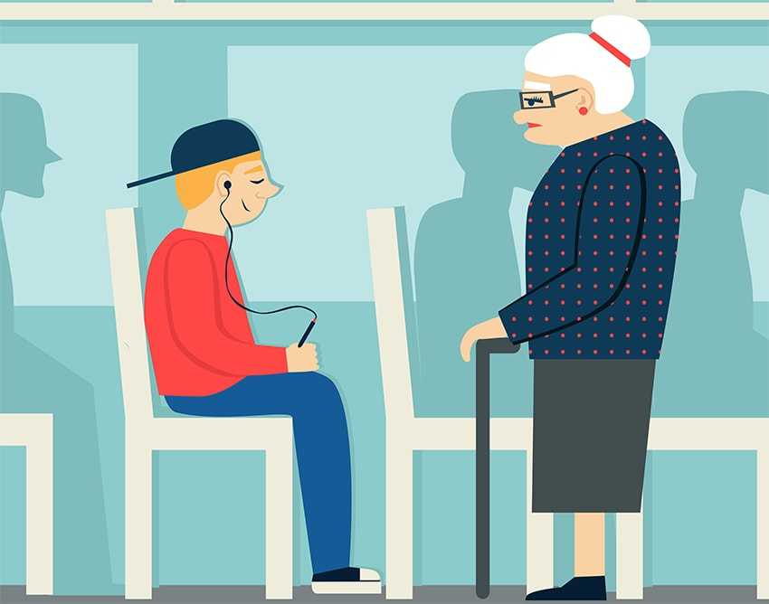
Folkways
Informal norms, also called folkways and customs, refer to standards of behavior that are considered less important but still influence how we behave.
E.g., Table manners are a common example of informal norms, as are such everyday behaviors as how we interact with a cashier and how we ride in an elevator.
Dressing Appropriately at Work. Wearing a School Uniform. Raising your Hand to Speak
They are customs that we follow but are often not written down. We learn them through intuition as we grow up. They are not strictly enforced.

Slide 15
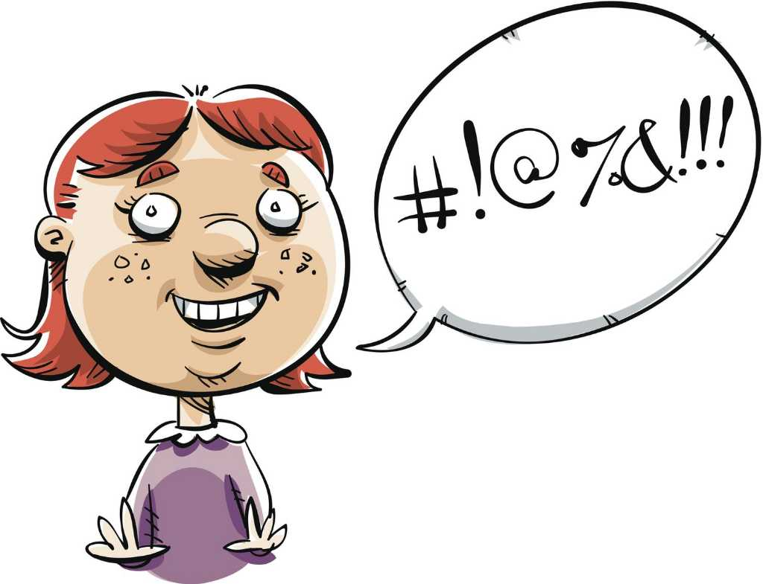
Taboo
Derived from the Tongan word “Tabu”, meaning “forbidden” or “prohibited”.
Taboos are ‘negative norms’ – things that people find offensive and socially inappropriate if you are caught doing them.
Taboo refers to actions, behaviors, or subjects that are considered forbidden, offensive, or socially unacceptable within a particular culture or society.
A norm so strong that it brings extreme sanctions, even revulsion, if violated. When someone breaks a taboo, the individual is usually judged unfit to live in the same society as others. The sanctions are severe and may include prison, banishment, or death.
It encompasses a wide range of practices, beliefs, and rituals that are considered to be improper or beyond the bounds of what is acceptable.
Incest, cannibalism (eating of human flesh by humans) and killing of parents.

Slide 16

FGM
Abortion
Sex Education
Child Marriage
Selecting a mate

Slide 17
Laws
Laws are norms that are actually defined as being legal or illegal.
The government has decided these norms are so important that you could get in trouble for breaking them.

Slide 18
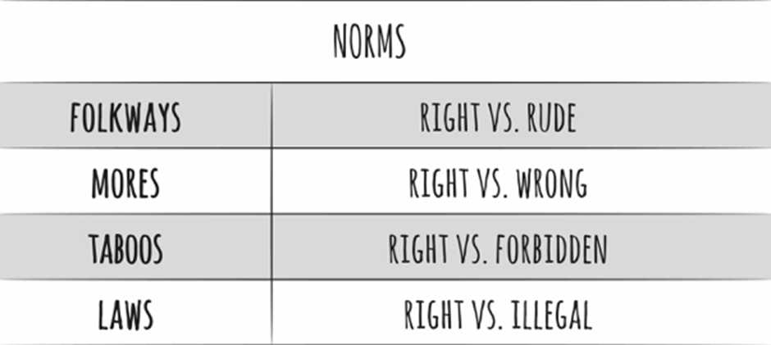

Slide 19
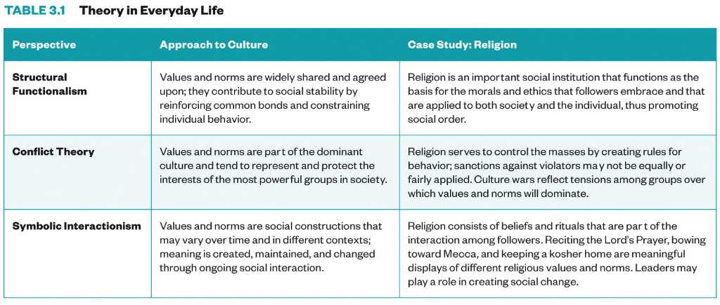

Slide 20
Culture Shock
Culture shock is the term we use to describe the feelings of confusion and uncertainty that are experienced when you come into contact with a culture that is vastly different from your own.
Can be commonly seen in foreign students, immigrants and refugees. Even students who stay in their home countries suffer from culture shock as they make the transition into the foreign environment such as college.
E.g., Imagine that you are an American college student going to study abroad in Australia for the summer. You are excited to take your first trip overseas and cannot wait to go. You figure that since it is an English-speaking country, it won't be that different from America. Once you step off the plane, reality sets in. You realize that although it was summer when you left home, it is winter in Australia. You have trouble following the language and find it hard to fit in. You feel alone and lonely, especially on the 4th of July when you would normally have a huge party with family and light fireworks. You cannot connect with any of the locals and feel like no one understands what you are going through. You cry at night and wish you were at home.

Slide 21
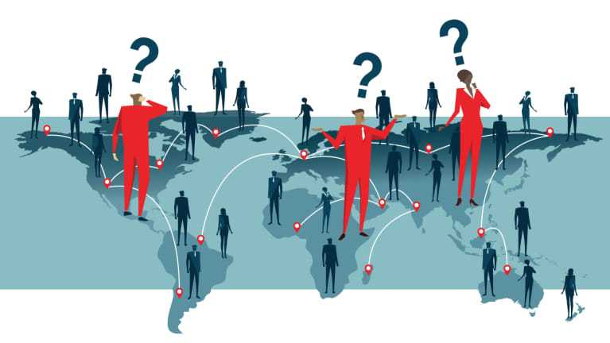
Culture shock is a two-way process.
On one hand, travelers experience culture shock when encountering people whose way of life is different. For example, North Americans who consider dogs beloved household pets might be put off by the Masai of eastern Africa, who ignore dogs and never feed them. The same travelers might be horrified to find that in parts of Indonesia and the People’s Republic of China, people roast dogs for dinner.
On the other hand, a traveler may inflict culture shock on local people by acting in ways that offend them. A North American who asks for a steak in an Indian restaurant may unknowingly offend Hindus, who consider cows sacred and never to be eaten.

Slide 22
Activity
Form a group
Write and then explain it to the class one cultural tradition that you find bizarre or feel that people from other culture may find it odd.
Explain the rationale behind the said cultural tradition.

Slide 23

What is your opinion about eating…
toasted ants?
Beetles? Flies?
Fried frog legs?
eating puppies and kittens?
eating brains scooped out of a living monkey?

